Slide 1
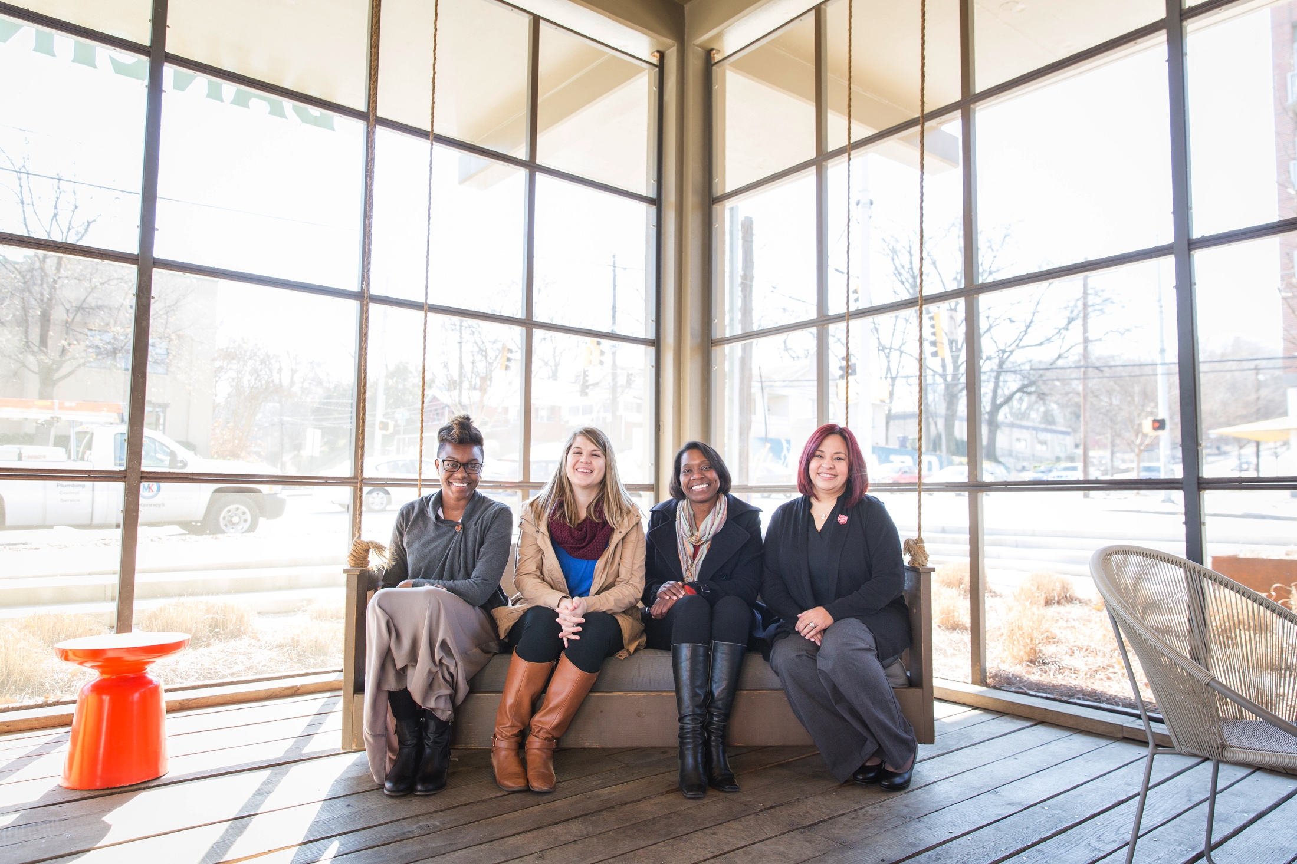
TERRITORIAL CONFERENCE FOR WOMEN LEADERS
Ages 21-40 September 23-25, 2016 Orlando, FL
DEADLINE EXTENDED!!
APPLY NOW THRU JULY 1
Notes:
Add Extended Application Deadline July 1st

Slide 2
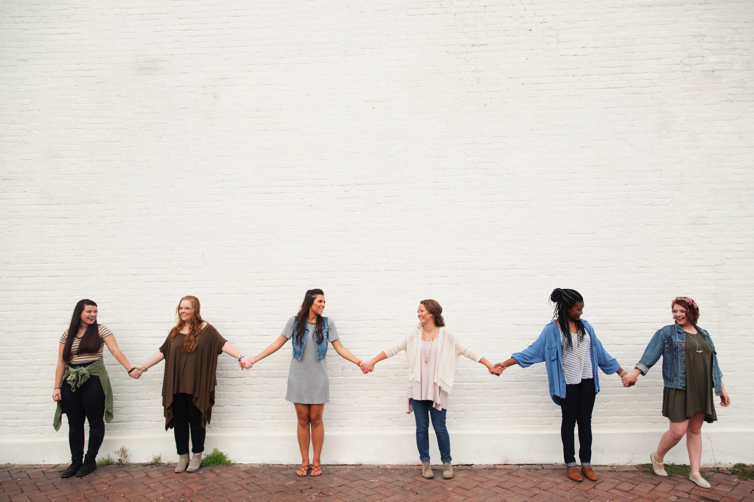
SPECIAL GUESTS
Commissioner Debi Bell Colonel Janet Munn Lt. Olivia Munn-Shirsath
Lt. Heather Dolby Lara Landon
Southern Territorial Creative Arts Team & Women Leaders of USA South!
DEADLINE EXTENDED!!!
APPLY NOW THROUH JULY 1ST!!!
Notes:
Add Extended Application Deadline July 1st

Slide 3
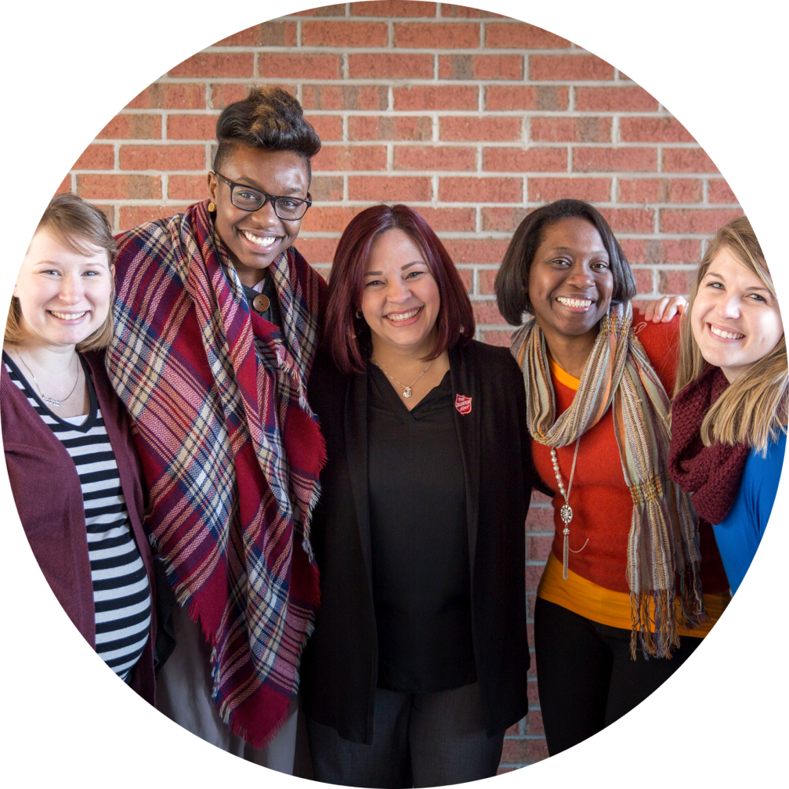
Costs:
Registration $75
Additional:
Hotel, Travel, Meals
DEADLINE EXTENDED!!
Apply Online now thru July 1
https://events.sauss.net
Notes:
Change to Apply through July 1st

Slide 4
See your Corps Officer for more information!
Visit us on Facebook:
www.facebook.com/sawomensministries

